Slide 1
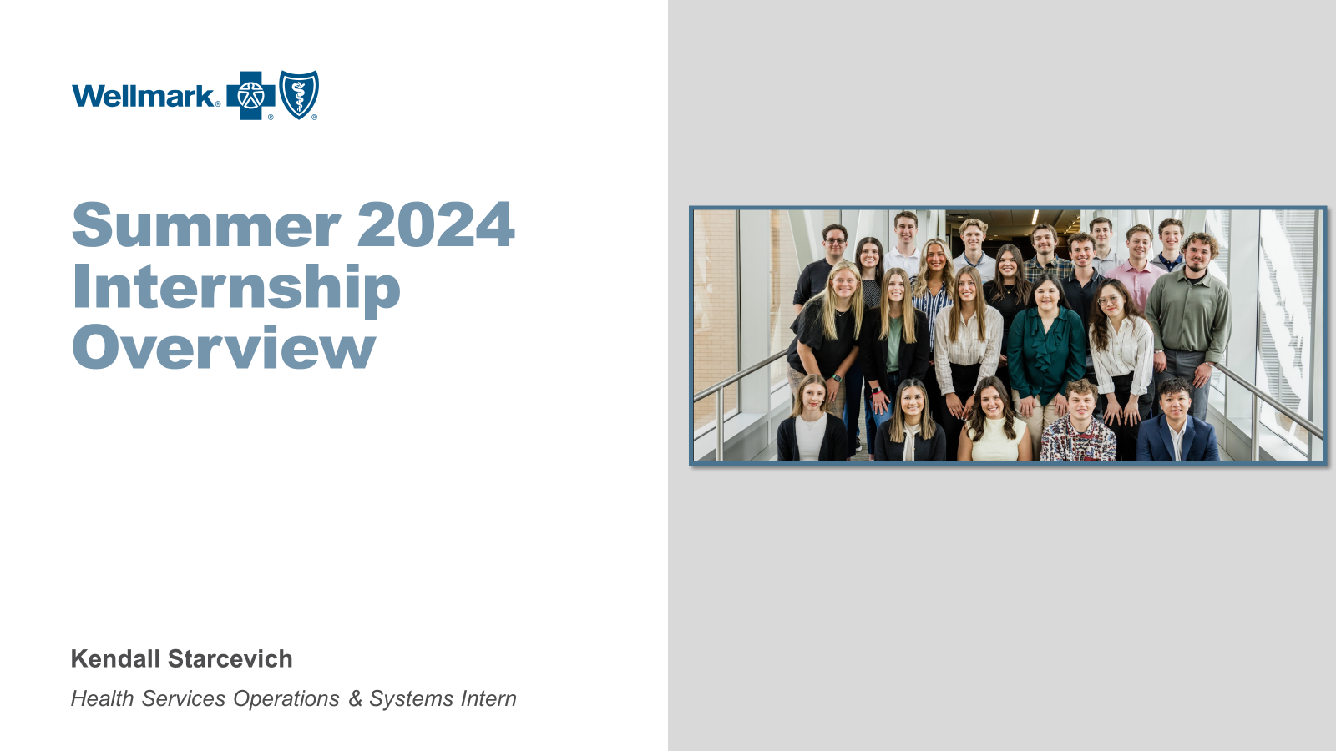

Slide 2
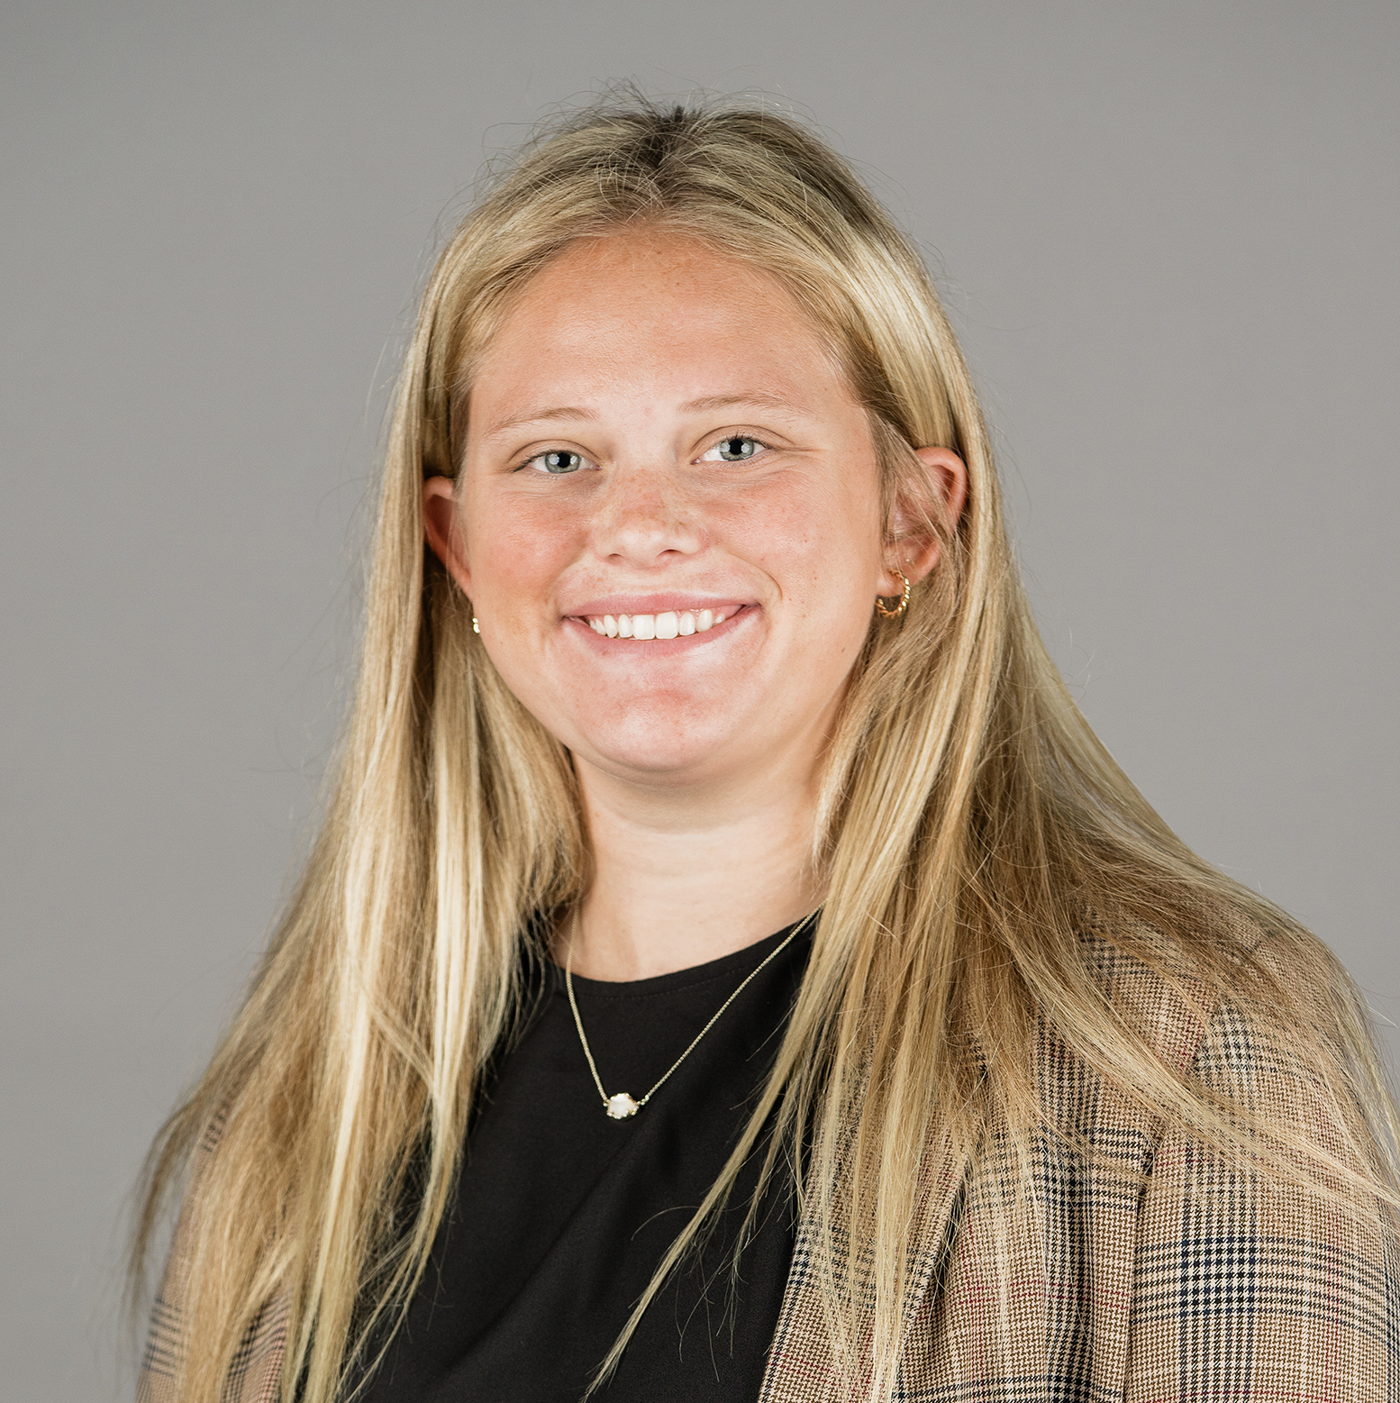
Kendall Starcevich
My Position
About Me
From Olathe, KS
3rd Year Division I Athlete – Women’s Soccer
Education
HS Operations & Systems Intern
Drake University, 2026
CS and Math Tutor
BS Computer Science, Data Analytics, Artificial Intelligence
Minor in Spanish
Operations & Business Support Team

Slide 3
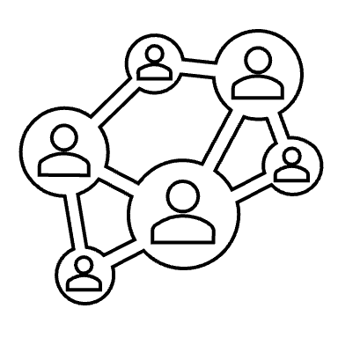
Learn the Business

Slide 4
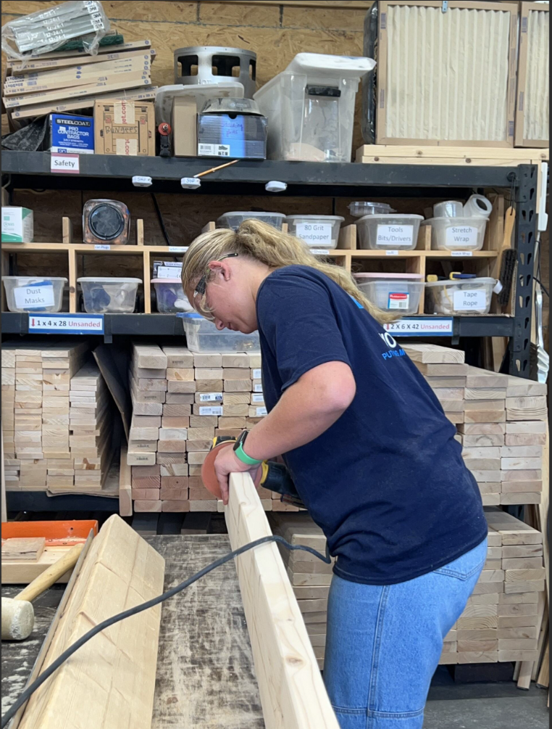
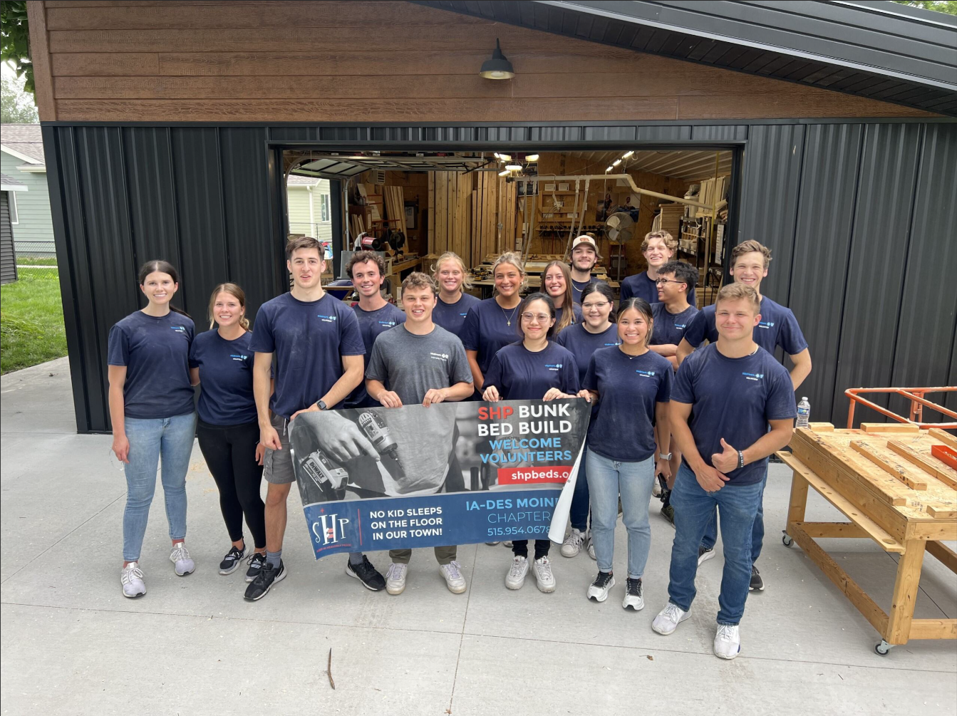
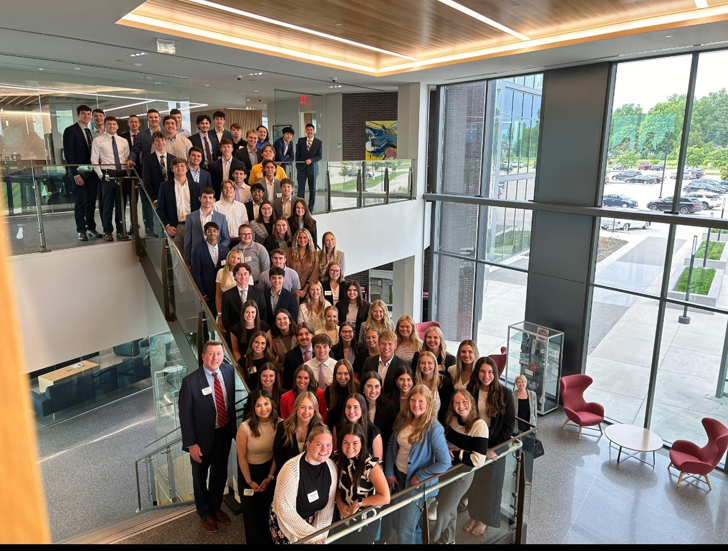
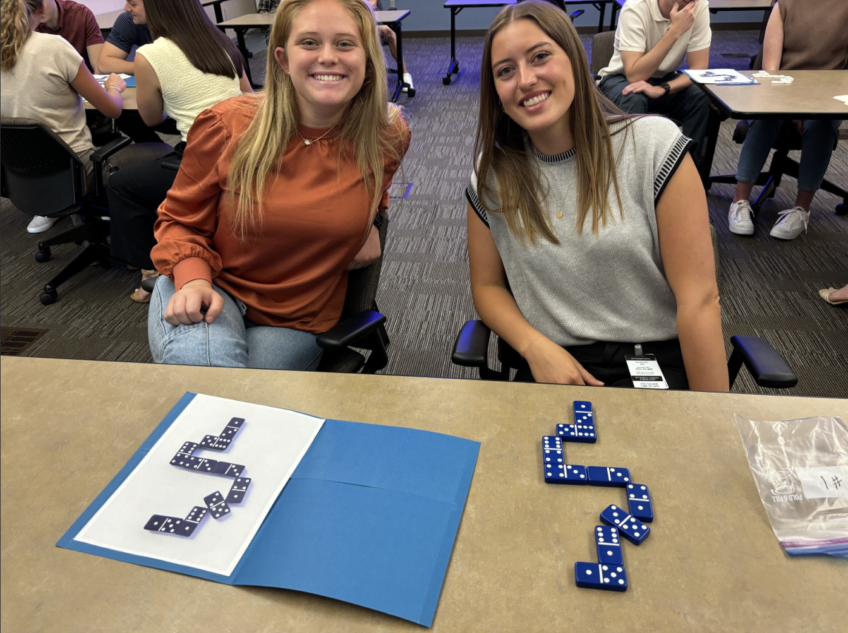
Learn the Business
Mentoring, Insure Your Future, Intern Programming, Shadowing,
Meet and Greets, Learning Modules, Agile Product Model

Slide 5

Run the Business

Slide 6
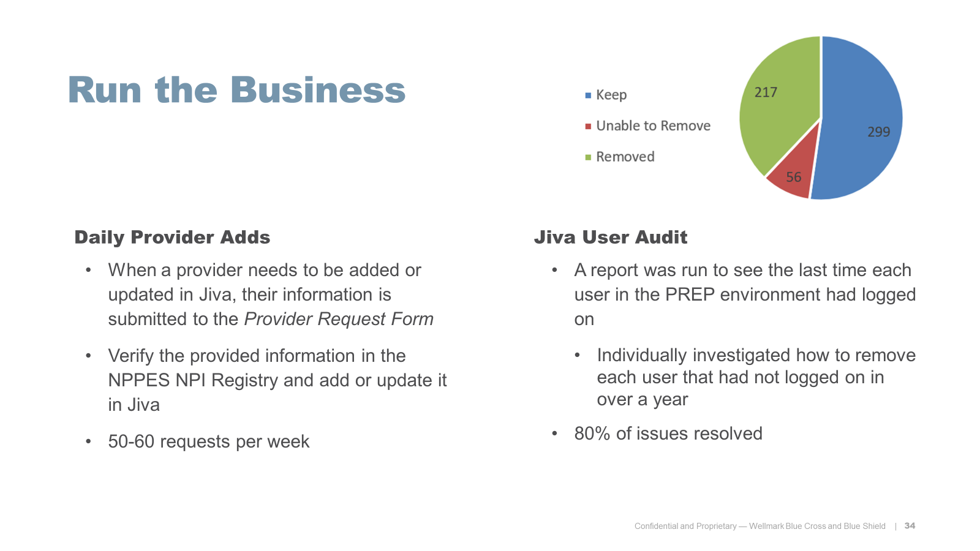

Slide 7
Hierarchy of Coverage
Group
Plan
WID
IOI
Company X
Blue Choice
W01234567
A4684D78-7536-4C16-994F-23456123456 ​
Notes:
Group Identifies the company
Plan identifies the specific policy selected
WID identifies members covered by the policy holder
IOI identifies the unique member

Slide 8
Coverage Data
Eligibility Data Warehouse
[EDW]
Coverage data passes through Rules and Logic, then sent to Jiva.
EVBI is the
Source of Truth
JIVA
FACETS
EVBI

Slide 9
Temp Member Merges
Temps are created by HS staff when a provider cannot find a member in Jiva, typically for newborns.
Coverage loaded in EVBI
Coverage added to IOI
Temp and IOI merge

Slide 10
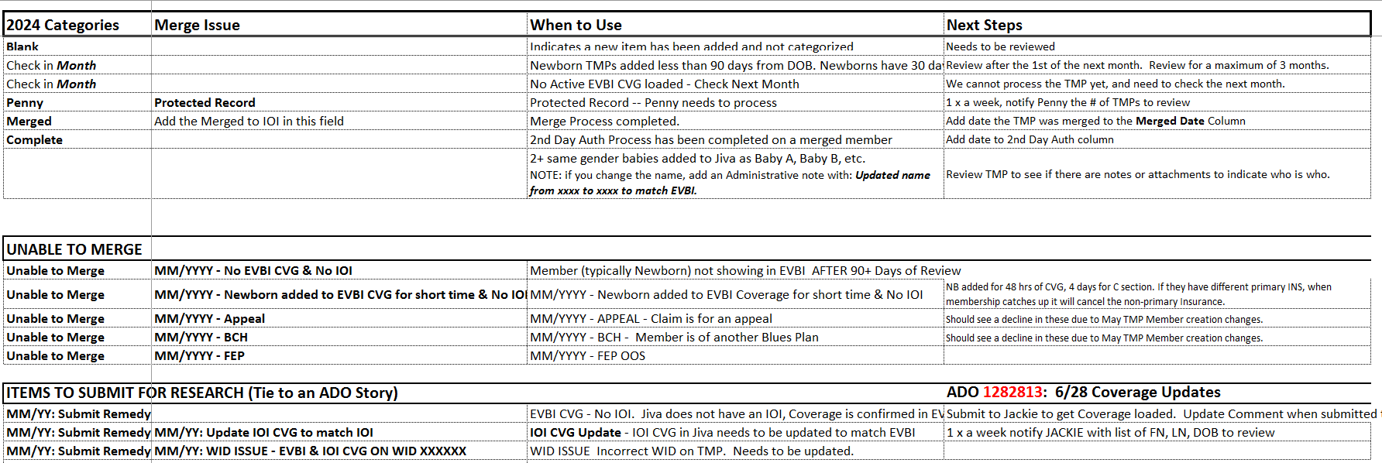
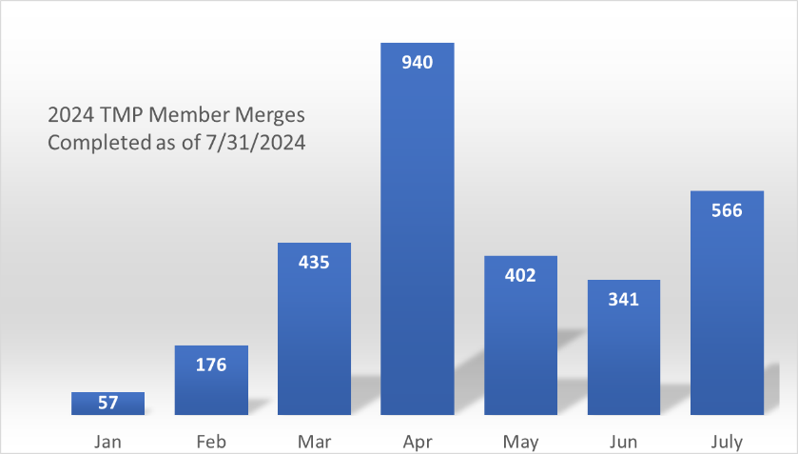

Slide 11

Improve the Business

Slide 12
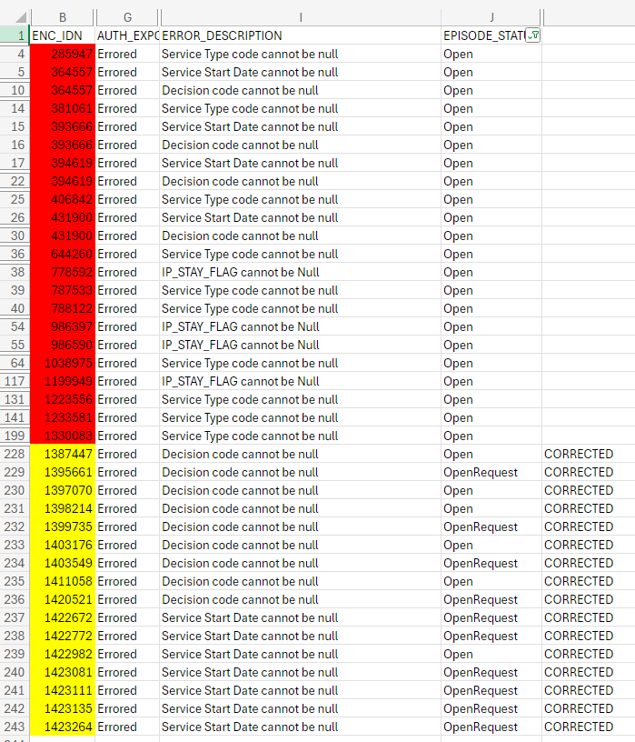
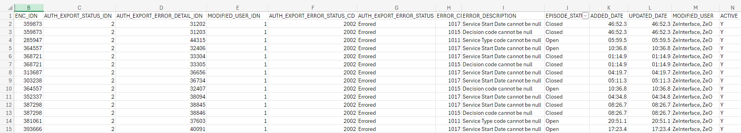
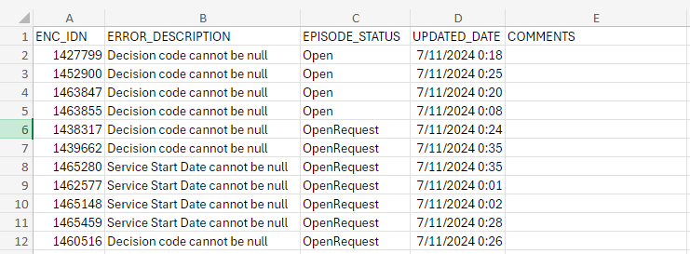
Jiva Daily UI Error Report Improvement
Before
After

Slide 13
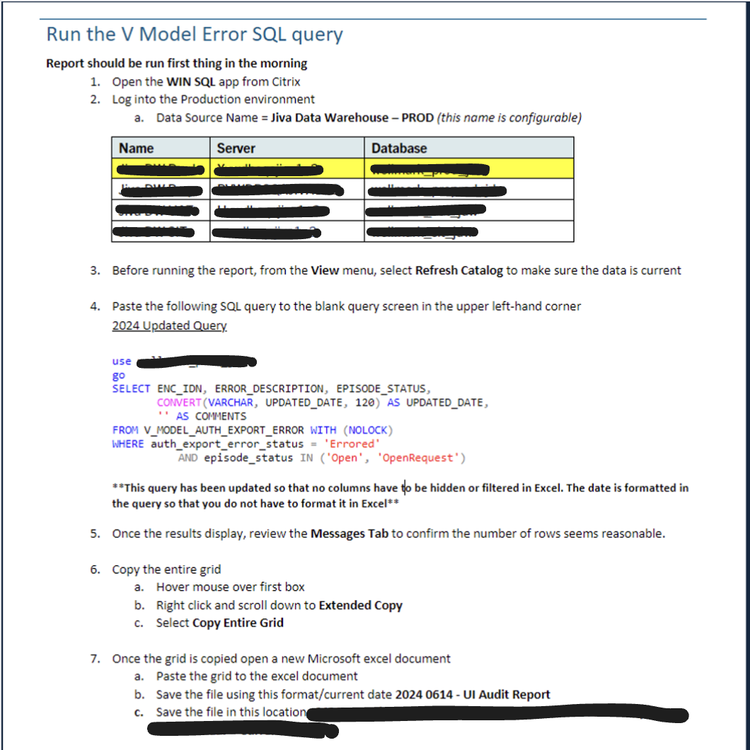
Documentation

Slide 14
Jiva Upgrade to 6.5 Testing
Started testing January 2024, going live on August 26th
Jiva is the system that Wellmark uses to manage their UM, CM, and Appeals processes
Third party system – the vendor pushes out regular upgrades/updates
To keep Wellmark on the latest version of Jiva, we must upgrade from 6.1 to 6.5
‘Unplug everything and plug it back in’
New servers, new infrastructure, almost completely new implementation
The business usually only tests in PREP – we also test in SIT/QES

Slide 15
Testing Meetings
Tech Calls
Advisor Testing
Coffee Chat
Strategy and planning for advisors
Check in with third party individuals who are testing
What technical defects have been identified and how can they be resolved?
Functional business testing by subject matter experts

Slide 16
Improve the Business
HSS Transactional Sync Validation
AWS Member Satisfaction Survey IVR Testing
Created episodes of each type/trait in Jiva PREP 6.1
After the sync was completed (3 weeks later), verified that each episode was correctly synced in Jiva PREP 6.5
Ran tests for a new over the phone survey
With a member after the closure call post-graduation of a program
Tested to make sure that the responses were being correctly recorded in the database.

Slide 17
Data Architecture
System Configuration
Relationships Between Data
Who is consuming your data and how are they using it?
Start to finish process – testing, maintenance
EVBI and Jiva
‘Trash in trash out’
Reflection

Slide 18
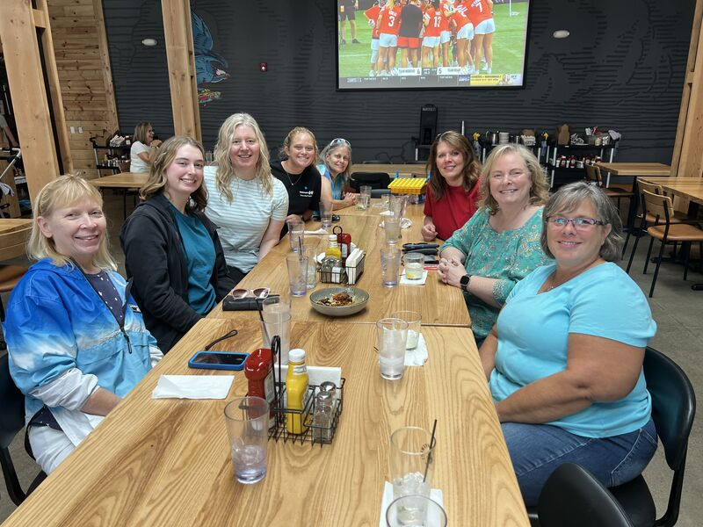
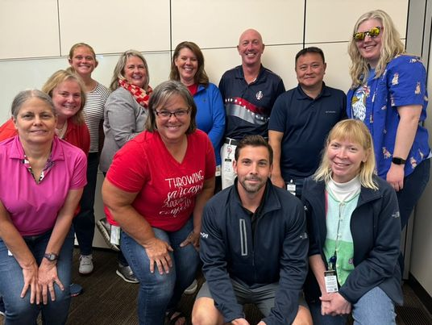
Thank you!
Staci Kinshella, Karla Gatewood, Kirstin Larsen
Stacy Lovan, Mallory Shafer

